Slide 1
LiverDisease
Diagnosis
Alekya Basike
Snithika Patel Talasani
Greeshma Naineni

Slide 2
Introduction
There are 5 stages of liver disease
Healthy liver
Inflammation
Scarring
Cirrhosis
Liver Cancer
End Stage Liver Disease

Slide 3
Screening and Diagnosis
Series of blood tests such as cellular enzymes, albumin, bilirubin, and proteins.
Imaging techniques such as Ultrasound and CT scans.
Look for symptoms such as fatigue, gastrointestinal bleeding, jaundice, abdominal pain

Slide 4
Problem
Most patients are asymptomatic.
Doctors have limited findings suggestive of the presence of the liver disease

Slide 5
Objective
Use blood test results and patient data to predict the presence of liver disease.

Slide 6
Project Plan
Data collection and preprocessing
Data modeling
Model evaluation and deployment

Slide 7
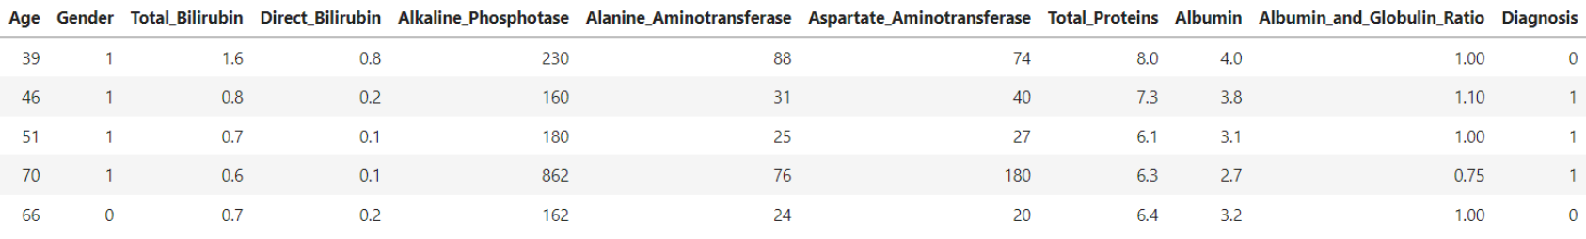
Dataset
583 patients record (416 liver patient, 167 non liver patient)
Target variable: Diagnosis is 0/1 indicating the presence of liver disease
Source :https://archive.ics.uci.edu/dataset/225/ilpd+indian+liver+patient+dataset

Slide 8
Data preprocessing
Steps taken for data preprocessing:
Filling null values with mean
Label encoding
Feature selection using Pearson Coefficient
Feature scaling
Oversampling for an imbalanced dataset

Slide 9
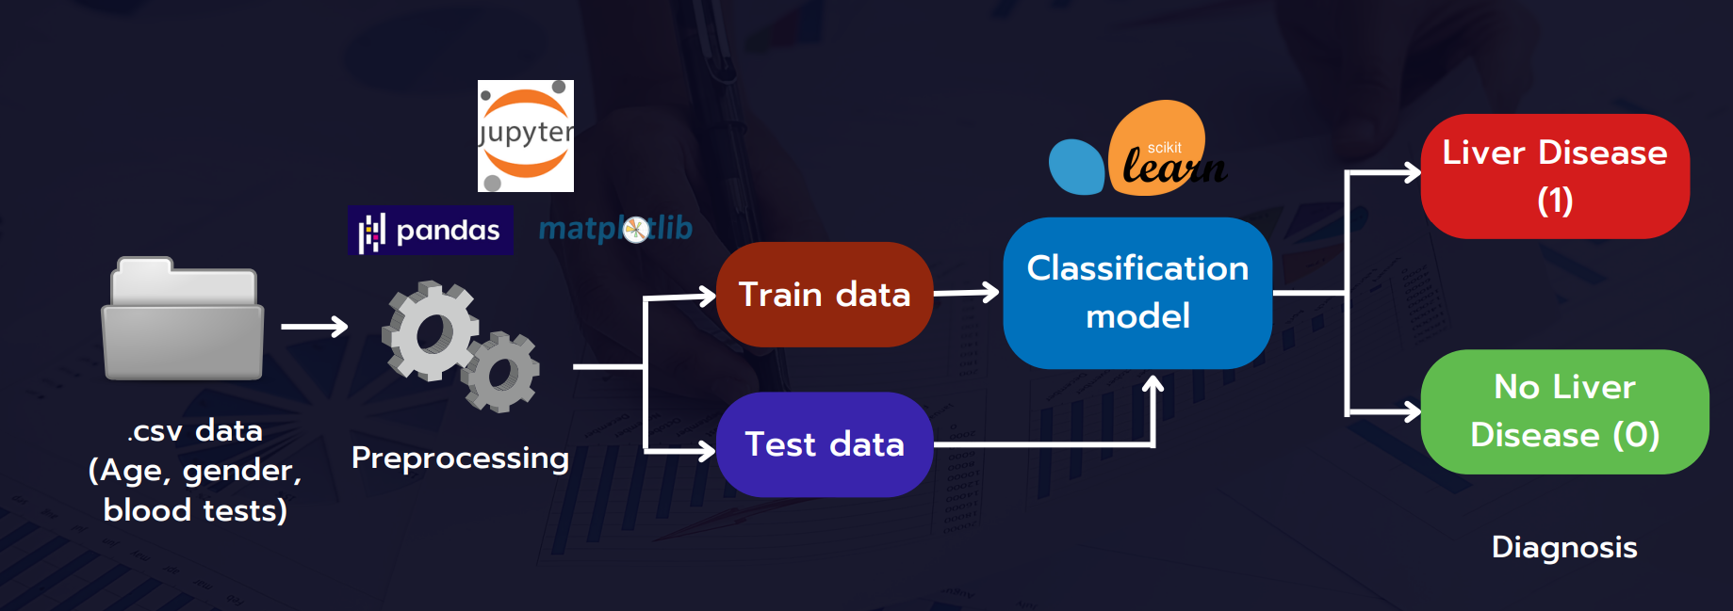
Training a classification model

Slide 10
libraries and dependencies
Libraries:
scikit-learn: for implementing logistic regression, KNN, SVC, Random forest.
NumPy : for numerical operations.
Matplotlib or Seaborn : for data visualization.
Pandas: for data manipulation and analysis.

Slide 11
Evaluation methodology
We have used 4 ML algorithms in our project to find the accuracy of the liver disease
Logistic Regression
KNN classifier
SVC
Random Forest Classifier

Slide 12
Liver Disease Classifier
Trained and evaluated classification models
Deployed the model with the highest accuracy

Slide 13
Results
Classification Model
Accuracy
Logistic Regression
Support Vector Classifier
Random Forest Classifier
K-Nearest Neighbours Classifier
76.75%
77.71%
76.57%
70.28%

Slide 14
Deployment
From the findings we have observed Support vector classification method gave us the highest accuracy.
So we choose SVC model for deployment
Deployed the application using Streamlit Open-source app framework for Machine Learning and Data Science
Automatically gets deployed as the GitHub repository is updated.

Slide 15
Thank you

